Slide 1
Reproducibility Project: Psychology
Ana Catarina Avila, Ting-Yi Su, Wan-Chun Su

Slide 2
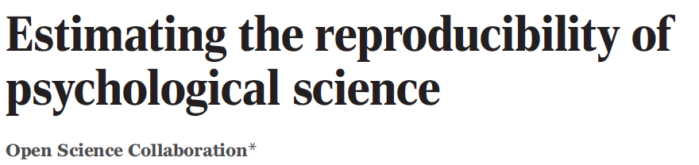

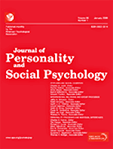

The Study
270 authors performed replication studies of 100 psychology publications to assess the reproducibility of the observed findings.
Articles all published in 2008
3 journals: Psychological Science, Journal of Personality and Social Psychology, and Journal of Experimental Psychology: Learning, Memory, and Cognition
Replication experiment: mostly last experiment in each article
Reproducibility metrics:
significance
P-values
Subjective assessments of replication teams
Effect sizes
Meta-analysis of effect sizes

Slide 3
Article Statistics
47% of original effect sizes were in the 95% CI of the replication effect size
39% of replication studies subjectively assessed to have replicated original results
Mean replication effect size (0.197) was about half of original (0.403)
 | % of studies w/ p-value < 0.05
Original | 97
Replication | 36

Slide 4
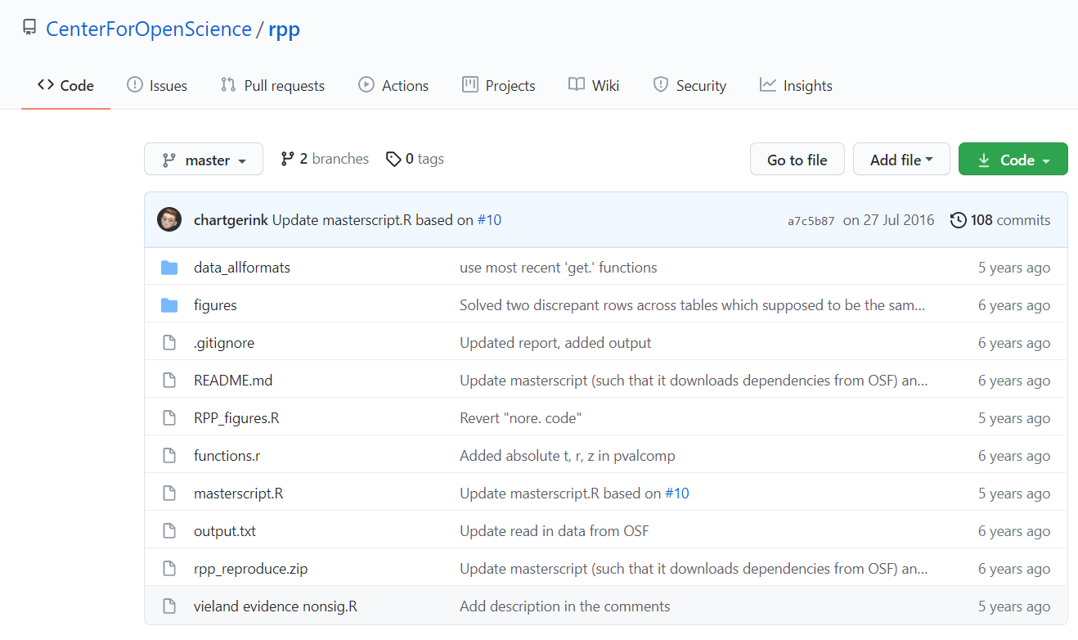
Reproducible?
Reproducing this reproducibility project
Github repository containing files needed to reproduce content of paper (https://github.com/CenterForOpenScience/rpp)
masterscript.R: for replicating statistical analyses
RPP_figures.R: for regenerating figures in the paper

Slide 5
Reproducing Statistical Analyses Results
 | Values obtained from our replication attempt | Values reported in paper | Same as paper?
How often original study is within 95% CI of replication study | 0.4736842 | 0.47 | Yes
Subset of data with all cases which were replicated | 0.39 | 0.39 | Yes
Mean replication effect size | 0.1969965 | 0.197 | Yes
Mean original effect size | 0.3962053 | 0.403 | No (rounding differences?)
Original % studies with p-value<0.05 | 0.97 | 0.97 | Yes
Replication % studies with p-value <0.05 | 0.36 | 0.36 | Yes

Slide 6
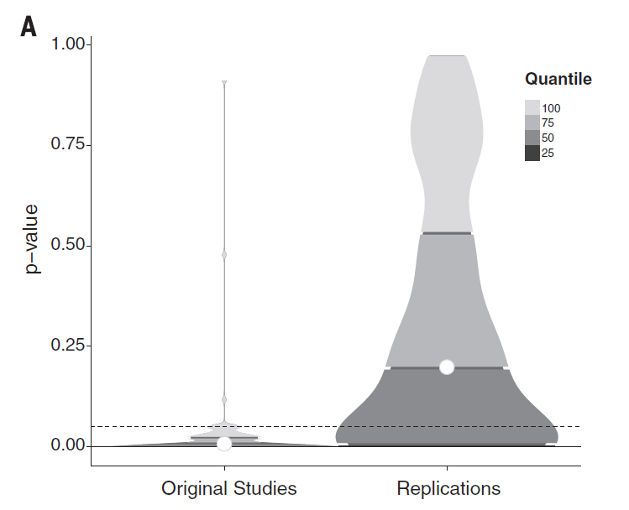
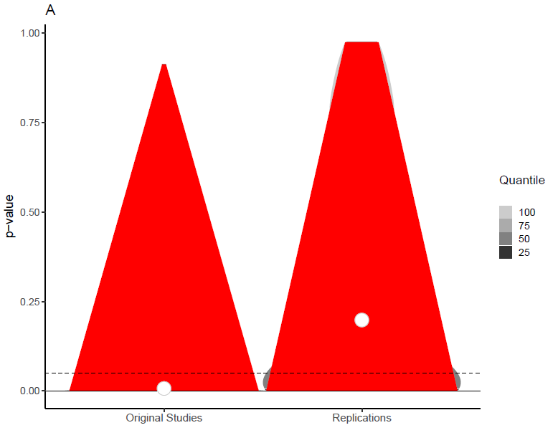
Issues with reproducing figures
Plotting functions producing N/A values (in red)
Violin plot showing original and replication study densities of p-values
Figure in paper
Our replication attempt

Slide 7
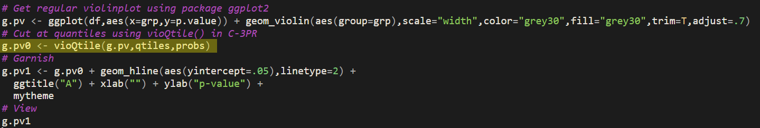
Issues with reproducing figures
vioQtile function: https://raw.githubusercontent.com/FredHasselman/toolboxR/master/C-3PR.R
Strange since it worked for the other violin plot that also used vioQtile
P-values are all real values

Slide 8
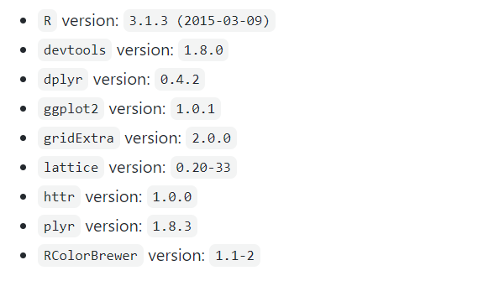
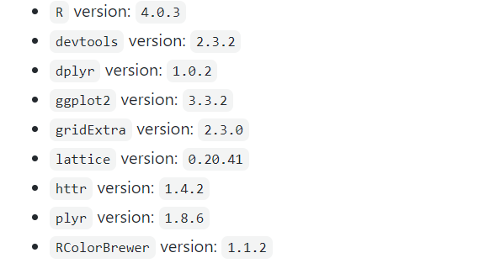
Potential causes of discrepancies
C-3PR.R file gets updated regularly
Different versions of R and R packages (most likely ggplot2)
Rounding differences and randomness
vs

Slide 9
“FORCE” for the reproducibility project
 | Findable | Accessible | Interoperable | Reusable | Citable
Data (csv file: https://osf.io/fgjvw/) | Yes | Yes | Yes | Yes | Yes
Software (Github code) | Not really | Yes | Not really | Depends | Yes
Narrative (Github README) | Not really | Yes | Yes | Yes | Yes
Individual replication study results (https://osf.io/ezcuj/wiki/Replicated%20Studies/) | Hard | Yes | Yes | Yes | Yes

Slide 10
Suggested Improvements
Timestamps for updates on data rather than simply overriding the old data without any notice
Saving current versions of any scripts sourced externally instead of downloading from a URL each time
Use the same versions of R and R packages for running the analyses and generating the figures (masterscript.R & RPP_figures.R)
Add a link to the article in the github README & a direct link to the github in the article

Slide 11
What does this replication teach us about research reusability?
Software:
Is not always accessible
doesn’t always work across different institutions
- Statistical results were easier to reproduce than figures (still within some variability)
- In this case, data was readily available
sampled from top journals, always the last experiment.
- Conclusions were confirmed.
Notes:
Dataset was large and unbiased - they explained how that worked
It would be possible to redo the experiment with different articles and the same methods.

Slide 12
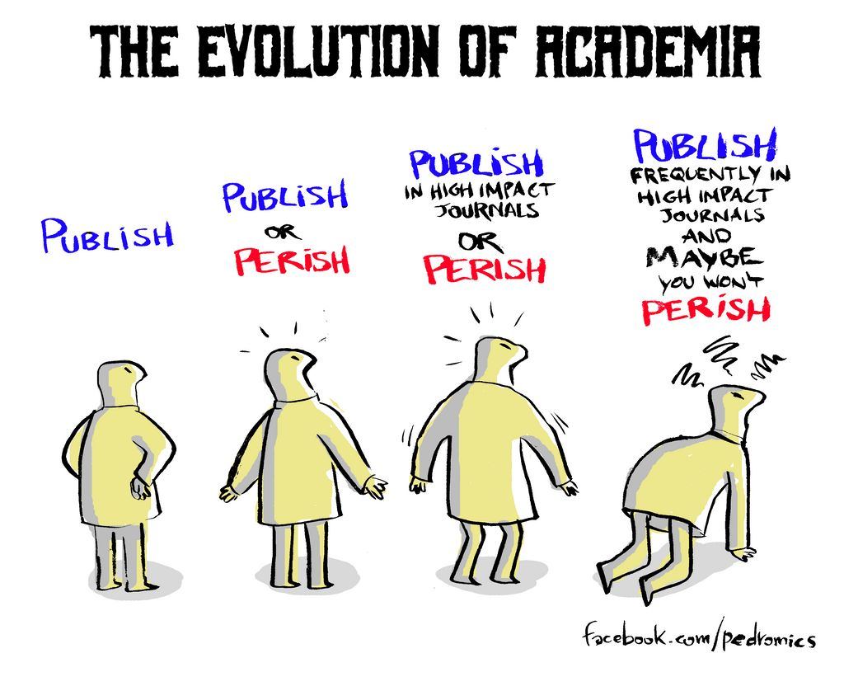
What does the study teach us about research reusability?
There is no standardization to evaluate replication success
- Reproduced studies tend to be less significant than original (type II errors are common)
- Science fosters novelty rather than replication
Notes:
better ways to make sure replications are easily compared.
Using those metrics (p-values, meta-analysis of effect sizes) as well as other metrics
Not a single metric is enough.
Replication can increase
certainty when findings are reproduced
and promote innovation when they are not.

Slide 13
What does related literature teach us about avoiding Type II errors?
Reproducing data collection rather than just data analysis
Large sample sizes (mainly in psychology) (Diener, E. & Biswas-Diener, R. (2021))
Importance of effect sizes (as was done in this study)
Quantitatively predict the relationship between variables (Francis 2012)
Standardization?
Meta-analysis of multiple replications?
Disclosure of non-significant results
Looking at distributions of multiple replication results (Shrout and Rodgers 2018)
“(...) We rethink the twentieth-century assumption that individual scientists can be trusted to report the relevant results and theorizing that led to the studies. Instead of trust, the theme of the new norms is openness.” (Shrout and Rodgers 2018)
Notes:
Readily available data
Standardize reproducibility of results

Slide 14
Thank You!
Diener, E. & Biswas-Diener, R. (2021). The replication crisis in psychology. In R. Biswas-Diener & E. Diener (Eds), Noba textbook series: Psychology. Champaign, IL: DEF publishers. Retrieved from http://noba.to/q4cvydeh
Francis G. The Psychology of Replication and Replication in Psychology. Perspectives on Psychological Science. 2012;7(6):585-594. doi:10.1177/1745691612459520

Slide 15
Assignment Guidelines
1. What is this article about ?
2. How reproducible is this article ?
- What technologies are used to help replicate the work ?
- What are the potential hurdles for a researcher trying to re-generate the results?
3. Evaluate "FORCE" . For all the research objects associated with the publication (ie, data, software, tools, narrative), evaluate how findable, accessible, interoperable, reusable and citable are the research objects?
4. Other thoughts / comments / ideas for improvements: What could the authors have done instead ?
You can choose to have one or several presenters (preferred option). Ideally, your presentation and notes would be uploaded in a git repository on GitHub.
d would like to emphasize that these are only to help you, the exercise is to make you reflect and report on the "reusability" of research.
d would like to emphasize that these are only to help you, the exercise is to make you reflect and report on the "reusability" of research.
d would like to emphasize that these are only to help you, the exercise is to make you reflect and report on the "reusability" of research.

